Slide 1
Inheritance
Object Oriented Programming
Lecture # 14
Prepared by: Mehak Usmani

Slide 2
Content
Inheritance Basics
Superclass & subclass
Using Super
Multilevel Hierarchy
Constructors’ calling sequence
Method Overriding
Abstract
Final

Slide 3
Inheritance
OOP
Abstraction
inheritance
Polymorphism
Encapsulation

Slide 4
Inheritance
Inheritance is one of the four pillars of object-oriented programming because it allows the creation of hierarchical classifications.
Using inheritance, a general class can be created that defines traits common to a set of related items. This class can then be inherited by other, more specific classes, each adding those things that are unique to it.
In the terminology of Java;
A class that is inherited is called a superclass.
The class that does the inheriting is called a subclass.
Therefore, a subclass is a specialized version of a superclass. It inherits all of the variables and methods defined by the superclass and adds its own, unique elements.

Slide 5

Basics
To inherit a class, simply incorporate the definition of one class into another by using the extends keyword.
The general form of a class declaration that inherits a superclass is shown here:
A hierarchy of inheritance can be created in which a subclass becomes a superclass of another subclass.
Only one superclass can be specified for any subclass.

Slide 6
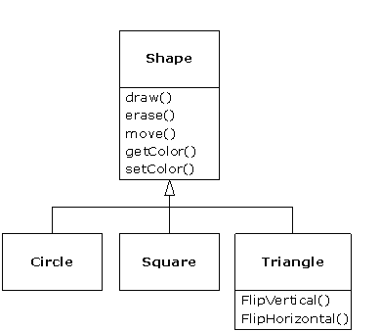
Example
In the example below, Shape is a superclass and Circle, Square and Triangle all are subclasses of Shape.

Slide 7
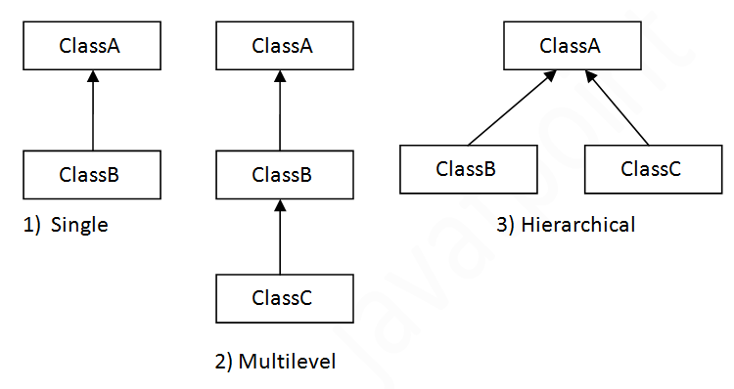
Types of inheritance
There can be three types of inheritance in java:
Single,
Multilevel
Hierarchical.
When a subclass inherits more than one class it is called Multiple Inheritance. In java programming, multiple inheritance is supported through interface only.

Slide 8
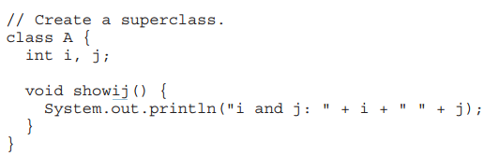
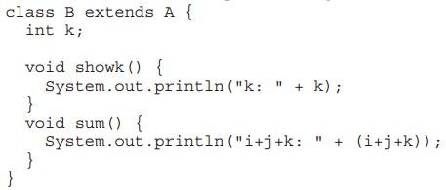
Applying Inheritance
To inherit a class, simply incorporate the definition of one class into another by using the extends keyword.

Slide 9
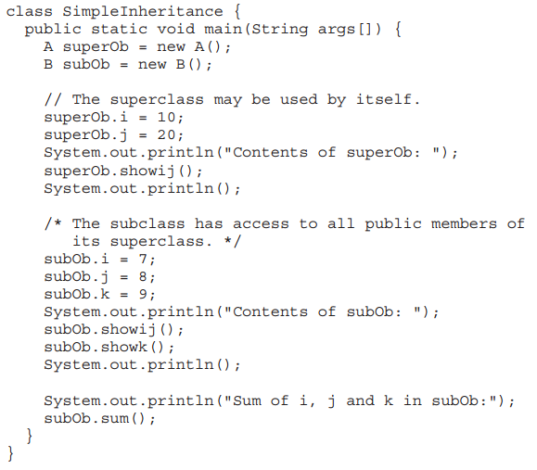

Slide 10
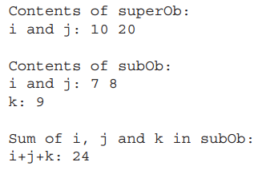
Output

Slide 11
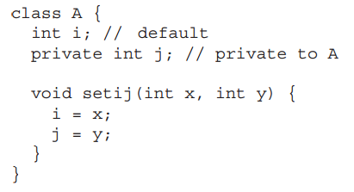
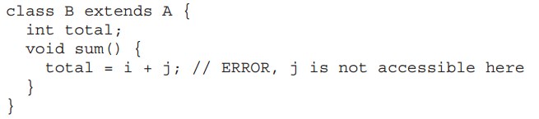
Member Access and Inheritance
A subclass includes all of the members of its superclass, it cannot access those members of the superclass that have been declared as private.

Slide 12
Example Box class
class Box {
double width;
double height;
double depth;
Box(){}
Box(double w, double h, double d) {
width = w;
height = h;
depth = d;
}
// compute and return volume
double volume() {
return width * height * depth;
}
}

Slide 13
Example Box class
class BoxWeight extends Box
{
double weight; // weight of box
BoxWeight(double w, double h, double d, double m) {
width = w;
height = h;
depth = d;
weight = m;
}
}
class DemoBoxWeight {
public static void main(String args[]) {
BoxWeight mybox1 = new BoxWeight(10, 20, 15, 34.3);
double vol;
vol = mybox1.volume();
System.out.println("Volume of mybox1 is " + vol);
System.out.println("Weight of mybox1 is " + mybox1.weight);
}
}

Slide 14
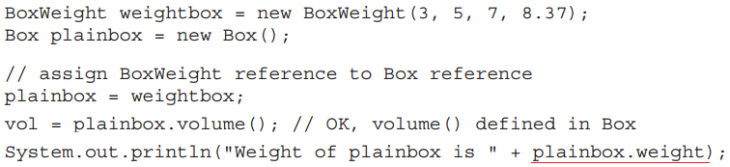
Superclass Variable referencing Subclass Object
A reference variable of a superclass can be assigned a reference to any subclass derived from that superclass.
When a reference to a subclass object is assigned to a superclass reference variable, it will have access to only those parts of the object that is defined by the superclass.
Error

Slide 15
Using super
When the constructor for subclass explicitly initializes the instance variables of its superclass, we repeat the same code found in its superclass, which is inefficient and it implies that a subclass must be granted access to these members.
There are cases when a superclass keeps the details of its implementation to itself, implementing encapsulation.
Whenever a subclass needs to refer to its immediate superclass, it can do so by use of the keyword super.

Slide 16
Using super
super has two general forms.
It can be used to
call the superclass’ constructor.
access a member of the superclass that has been hidden.

Slide 17
Using super to Call Superclass Constructors
A subclass can call a constructor defined by its superclass by use of the following form of super:
Here, arg-list specifies any arguments needed by the constructor in the superclass.
super( ) must always be the first statement executed inside a subclass’ constructor.
super( ) always refers to the superclass immediately above the calling class. This is true even in a multileveled hierarchy.

Slide 18
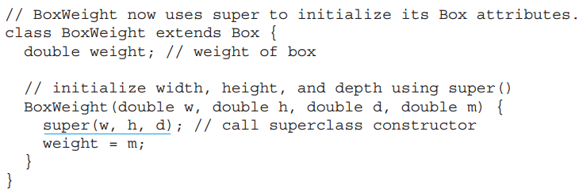
Using super to Call Superclass Constructors

Slide 19
Using super to access members of Superclass
The second form of super acts somewhat like this, except that it always refers to the superclass of the subclass in which it is used.
This usage has the following general form:
Member can be either a method or an instance variable.
This second form of super is most applicable to situations in which member names of a subclass hide members by the same name in the superclass.

Slide 20

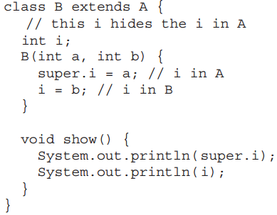
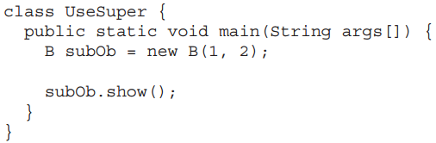
Using super to access members of Superclass

Slide 21
Practice!
Write a java Program considering the following scenario.
Mobile is an Object that contains basic functionalities including Calling & Receiving a call & Messaging. The Mobile has certain features including Processor, internal memory, single or dual SIM, weight. The IMEI number is only used for identifying the device.
There can be different mobiles like Samsung, iPhone or Nokia which have their own features along with the basic functionality of a mobile phone.
In case of Samsung, the Android version, Camera Specs and playing FM Radio, capturing photos.
iPhone may have an ios version, Music Player, Camera.
Any of these mobile phones can be used to make a call or send a text message.

Slide 22
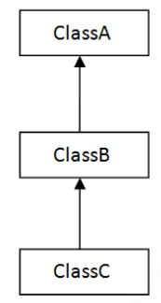
Creating a Multilevel Hierarchy
Class hierarchies can be built that contain many layers of inheritance.
In Java it is perfectly acceptable to use a subclass as a superclass of another.
For example, given three classes called A, B, and C, C can be a subclass of B, which is a subclass of A.
C inherits all aspects of B and A.

Slide 23
class Box {
private double width;
private double height;
private double depth;
// compute and return volume
double volume() {
return width * height * depth;
}
class BoxWeight extends Box {
double weight; // weight of box
.
.
}
// Add shipping costs.
class Shipment extends BoxWeight {
double cost;
Shipment(int i, int j, int k, int l, int m) {
super(i,j,k,l);
cost = m; }
}
class DemoShipment {
public static void main(String args[]) {
Shipment shipment1 = new Shipment(10, 20, 15, 10, 3.41);
double vol = shipment1.volume();
System.out.println("Volume is " + vol);
System.out.println("Weight is " + shipment1.weight);
}
}

Slide 24
When Constructors Are Called!
When a class hierarchy is created, in what order are the constructors for the classes that make up the hierarchy called?
ClassA() {}
ClassC obj= new ClassC();
ClassB() {}
ClassC() {}

Slide 25
When Constructors Are Called!
In a class hierarchy, constructors are called in order of derivation, from superclass to subclass.
Further, since super( ) must be the first statement executed in a subclass’ constructor, this order is the same whether or not super( ) is used.
If super( ) is not used, then the parameter-less constructor of each superclass will be executed.

Slide 26
When Constructors Are Called!
class A {
A() {
System.out.println
("Inside A's constructor.");
}
}
class B extends A {
B() {
System.out.println
("Inside B's constructor.");
}
}
class C extends B {
C() {
System.out.println
("Inside C's constructor.");
}
}
class CallingCons {
public static void main(String args[]) {
C objectC = new C();
}
}

Slide 27
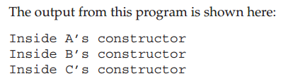
When Constructors Are Called!
A superclass has no knowledge of any subclass, any initialization it needs to perform is separate from and possibly prerequisite to any initialization performed by the subclass. Therefore, it must be executed first.

Slide 28
Constructor Chaining
Constructor Chaining is nothing but calling one Constructor from another.
We can use this keyword and super keyword in calling a constructor.
this can be used to call a constructor within the same class.
super can be used to call the constructor of the Parent class
if you didn’t call the Parent class Constructor then the compiler will be automatically calling the Parent class no-args constructor by itself.
this() will call the Default Constructor of the same class whereas this(parameter) will call a parameterized constructor of the same class.
Same way super() will call the Default constructor of the Parent class whereas super(parameter) will call a parameterized constructor of the Parent class.

Slide 29
Method Overriding
OOP
Abstraction
inheritance
Polymorphism
Encapsulation
Overloading
Overriding

Slide 30
Method Overriding
In a class hierarchy, when a method in a subclass has the same name and type signature as a method in its superclass, then the method in the subclass is said to override the method in the superclass.
When an overridden method is called from within a subclass, it will always refer to the version of that method defined by the subclass. The version of the method defined by the superclass will be hidden.
In order to access the superclass version of an overridden method, super can be used.

Slide 31
Method Overriding
class Parent
{ void show(){
System.out.println("Parent called");
}
}
class Child extends Parent
{ void show(){
System.out.println("Child called");
}
}
Child c = new Child();
c.show();
Output:
Child called

Slide 32
Method Overriding
class Parent
{ void show(){
System.out.println("Parent called");
}
}
class Child extends Parent
{ void show(){
super.show();
System.out.println("Child called");
}
}
Child c = new Child();
c.show();
Output:
Parent called
Child called

Slide 33
Method Overriding
Method overriding occurs only when the names and the type signatures of the two methods are identical. If they are not, then the two methods are simply overloaded.

Slide 34
Method Overriding
class Parent
{ void show(){
System.out.println("Parent called");
}
}
class Child extends Parent
{ void show(String msg){
System.out.println(msg);
}
}
Child c = new Child();
c.show();
c.show(“Overloading”);
Output:
Parent called
Overloading

Slide 35
Abstract Method
There are cases when we have to create a superclass that only defines a generalized form that will be shared by all of its subclasses, leaving it to each subclass to fill in the details.
In order to ensure that a subclass does, indeed, override all necessary methods, Java provides abstract methods. Certain methods can be made mandatory to be overridden by subclasses by specifying the abstract type modifier.
To declare an abstract method, use this general form:
abstract type name(parameter-list);
abstract methods are sometimes referred to as subclasser responsibility because they have no implementation specified in the superclass.

Slide 36
Abstract Classes
Any class that contains one or more abstract methods must also be declared abstract.
To declare a class abstract, abstract keyword is used in front of the class keyword at the beginning of the class declaration.
abstract class class_name {
abstract type method();
}
There can be no objects of an abstract class. That is, an abstract class cannot be directly instantiated with the new operator. Such objects would be useless, because an abstract class is not fully defined.
Abstract constructors, or abstract static methods cannot be declared.
Abstract classes can include non-abstract methods also.

Slide 37
abstract class A {
abstract void callme();
void callmetoo() {
System.out.println("This is a concrete method.");
}
}
class B extends A {
void callme() {
System.out.println("B's implementation of callme.");
}
}
class AbstractDemo {
public static void main(String args[]) {
B b = new B();
b.callme();
b.callmetoo();
}
}

Slide 38
final - with Inheritance
The keyword final has three uses.
It can be used to create the equivalent of a named constant.
Using final to Prevent Overriding.
Using final to Prevent Inheritance

Slide 39
Using final to Prevent Overriding
To disallow a method from being overridden, specify final as a modifier at the start of its declaration.
Methods declared as final cannot be overridden.
Methods declared as final can sometimes provide a performance enhancement: The compiler is free to inline calls to them because it “knows” they will not be overridden by a subclass*.
Inlining is only an option with final methods. Normally, Java resolves calls to methods dynamically, at run time. This is called late binding.
However, since final methods cannot be overridden, a call to one can be resolved at compile time. This is called early binding.
Notes:
* When a small final method is called, often the Java compiler can copy the bytecode for the subroutine directly inline with the compiled code of the calling method, thus eliminating the costly overhead associated with a method call

Slide 40
class A {
final void method() {
System.out.println("This is a final method.");
}
}
class B extends A {
void method() { // ERROR! Can't override.
System.out.println("Illegal!");
}
}

Slide 41
Using final to Prevent Inheritance
In order to prevent a class from being inherited, the class is made final.
To do this, precede the class declaration with final.
Declaring a class as final implicitly declares all of its methods as final, too.
It is illegal to declare a class as both abstract and final since an abstract class is incomplete by itself and relies upon its subclasses to provide complete implementations.

Slide 42
final class A {
// ...
}
// The following class is illegal.
class B extends A { // ERROR! Can't subclass A
}

Slide 43
Summarizing the concepts
What is superclass and subclass in java refers to?
Which keyword is used to inherit class’s method and data?
Which type of inheritance is not directly supported in Java?
What is constructor chaining?
Can a reference variable of one class hold object of another class?
Can a child reference variable hold reference to parent object?
What is the use of super?
How method overriding is different from method overloading?
To make class unable create its object, which modifier is used with the class?
To make class unable to be inherited by other classes, which modifier is used with the class?
What are the difference between abstract and final keywords?

